Slide 1

SCM Automation in Partnership with Moon Bouncer
Session 41
Presenter : Adapt IT and Moon Bouncer

Slide 2

Content
About Moon Bouncer
  Mzimhle Mbijekana
Challenges at the Institutions
  Brilliant Tleane
Benefits of the Integration
  Brilliant Tleane
To-Be Process
  Bernard Mostert
MoonFlow Integration
  Willie de Jonge
Way Forward
  JJ Swanepoel

Slide 3

About Moon Bouncer
Moon Bouncer has entered into a partnership with Adapt IT to Interface with MoonFlow solution for SCM automation at Institutions.
The integration will cover four main modules, namely:
  Supplier Registration,
  Supplier Rotation in RFQ’s,
  Contract Management,
  Tender Administration
These processes will be developed and implemented in a phased approach
Procurement management and processing of requests/transactions to remain in the ITS system.

Slide 4

Challenges at Institutions
Onboarding of Suppliers manually
Sourcing of quotations from suppliers not listed on CSD
No proper system to monitor the rotation of suppliers
Staff intentionally not rotating in sourcing quotations because they colluding with suppliers.
Sourcing of quotation is not a transparent process

Slide 5






Benefits
Accelerate supplier registration and maintenance processes
Faster turnaround time on sourcing for Quotations from suppliers
Real-time vetting of suppliers against CSD and update the ITS system
Eliminate manual process on RFQs and rotation of suppliers
Gain better oversight and control over your contracts
Effective contract management and tender administration

Slide 6
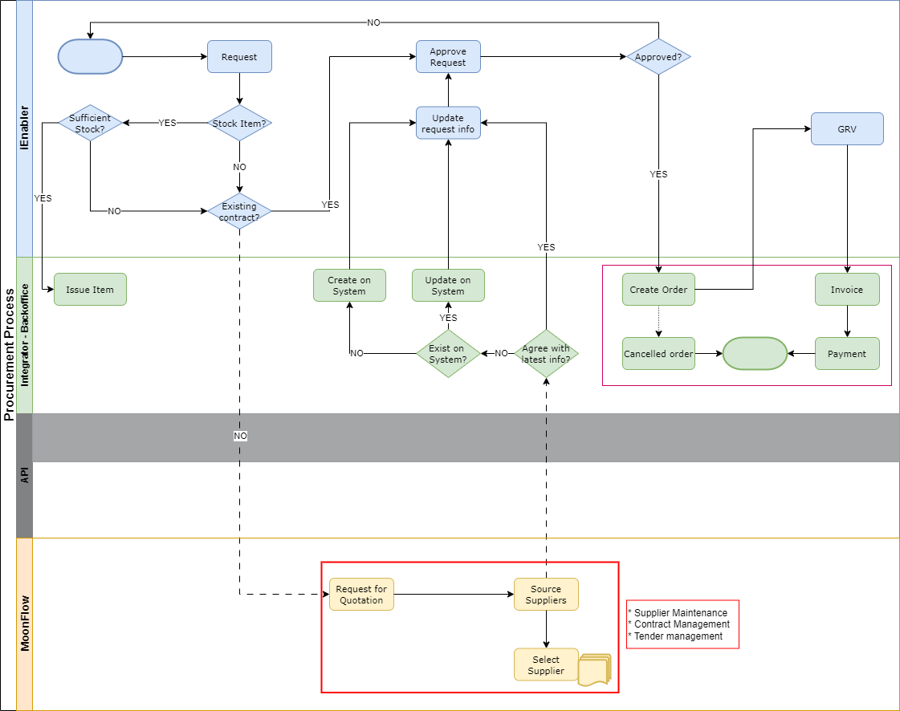
To-Be Process

Slide 7
7
Supplier Registration
Disclaimer:
System demonstration to be presented after focused functionality showcase.

Slide 8
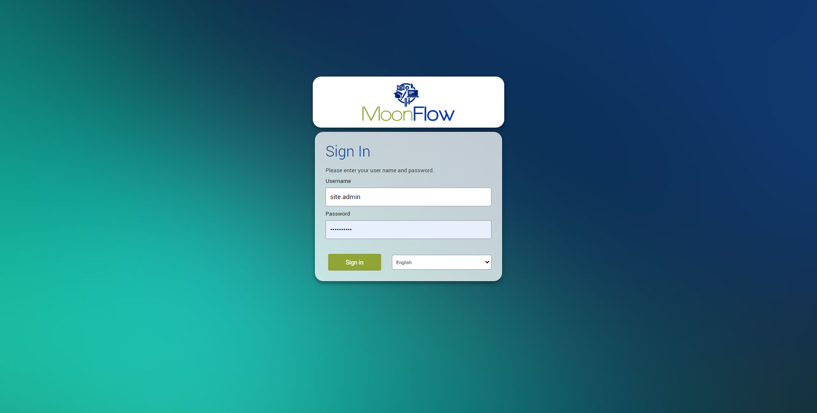
Supplier Registration Initiation
8

Slide 9
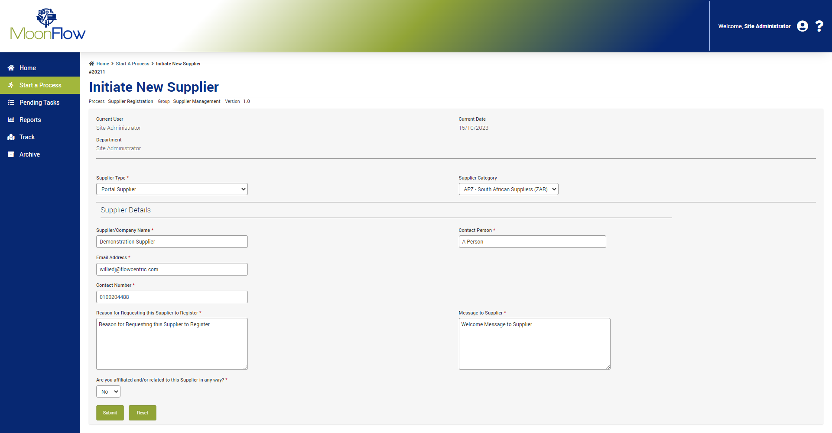
Supplier Registration Initiation
9

Slide 10
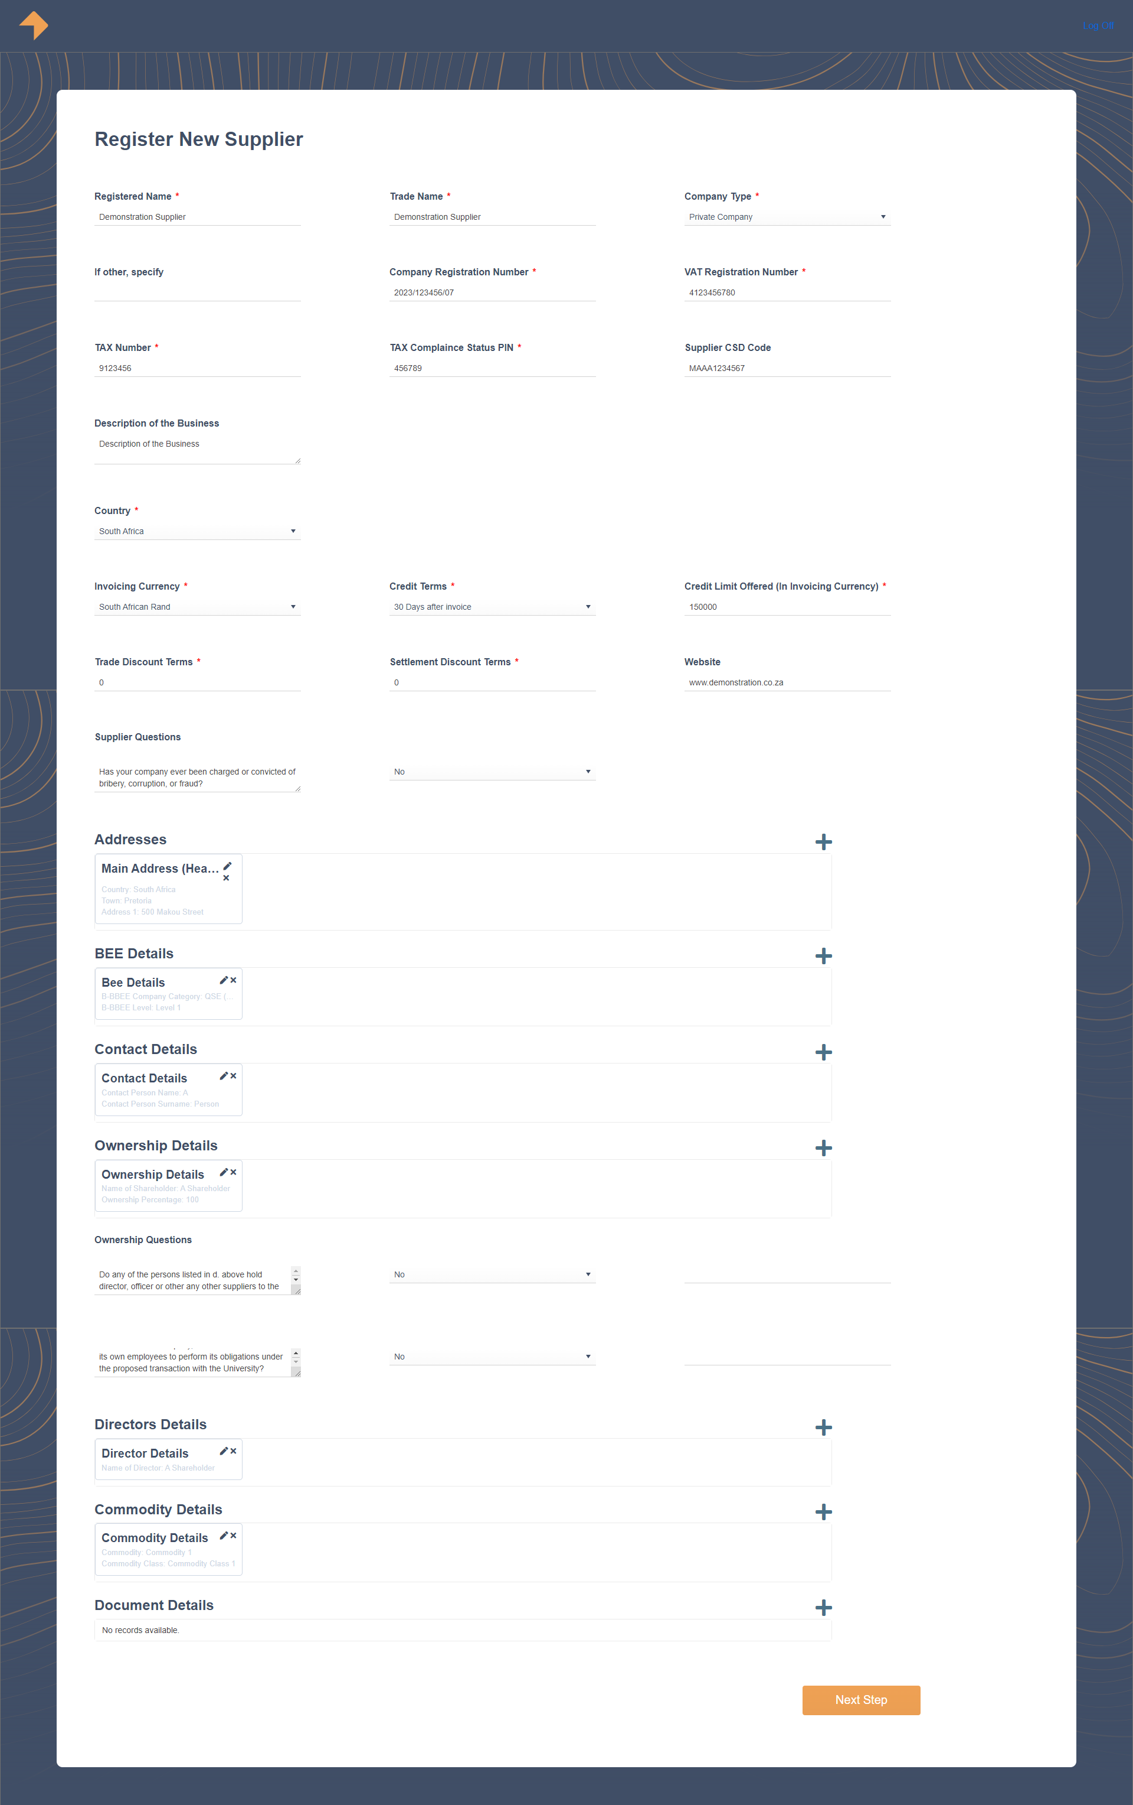
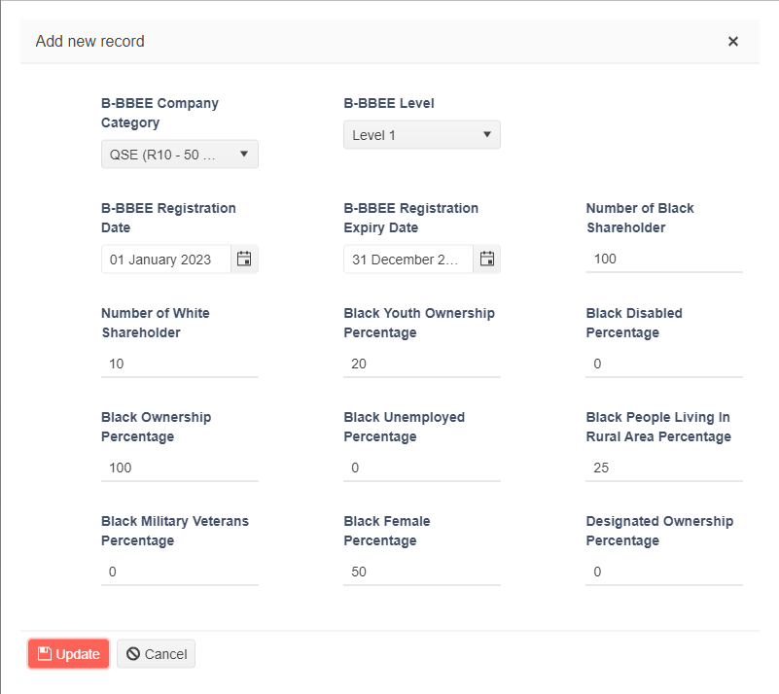
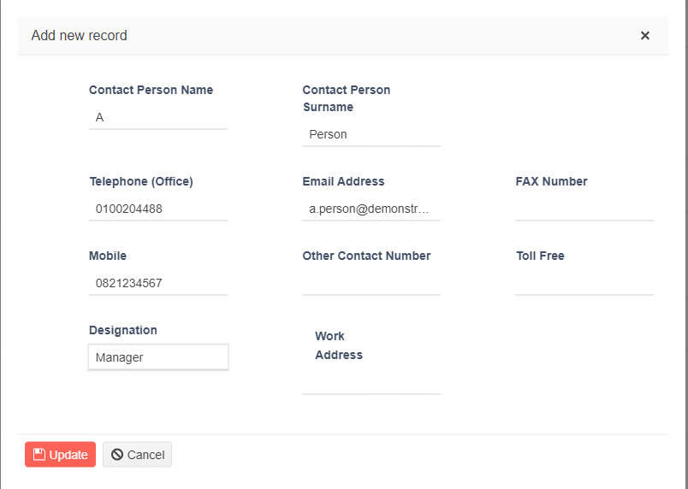
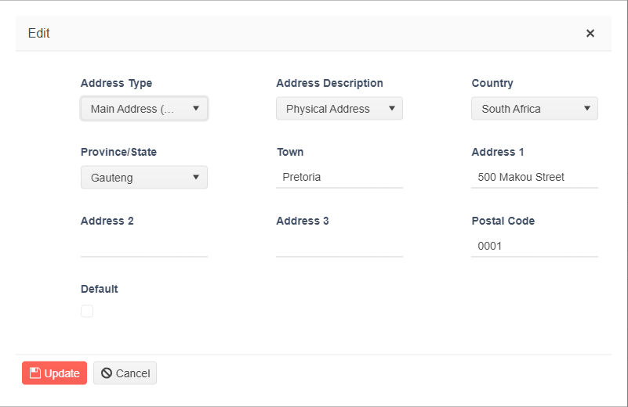
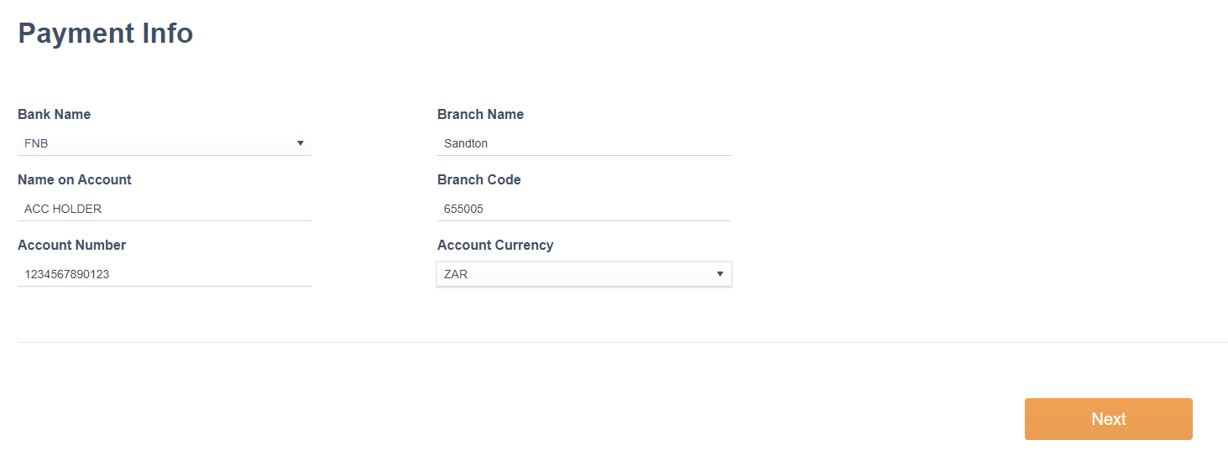
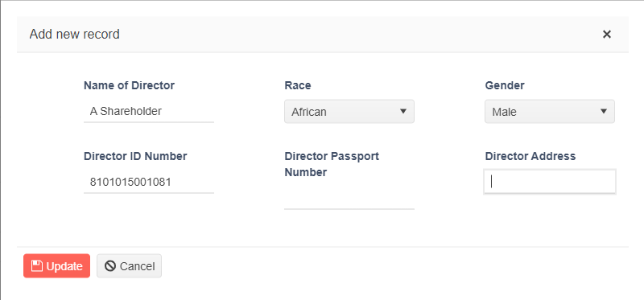
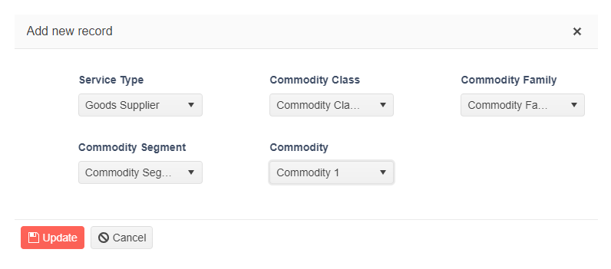
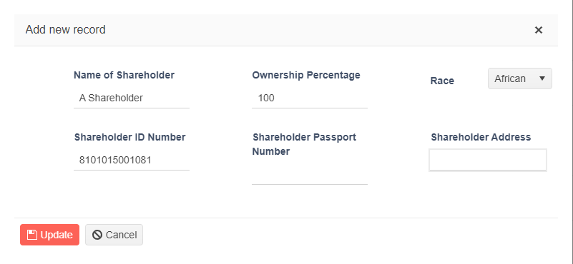
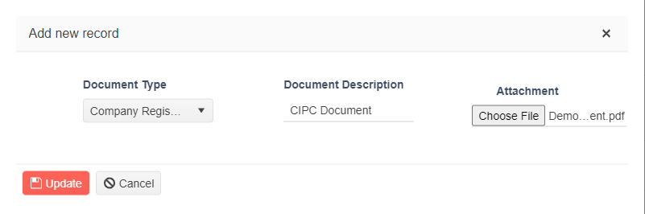
Supplier Registration Initiation
10

Slide 11
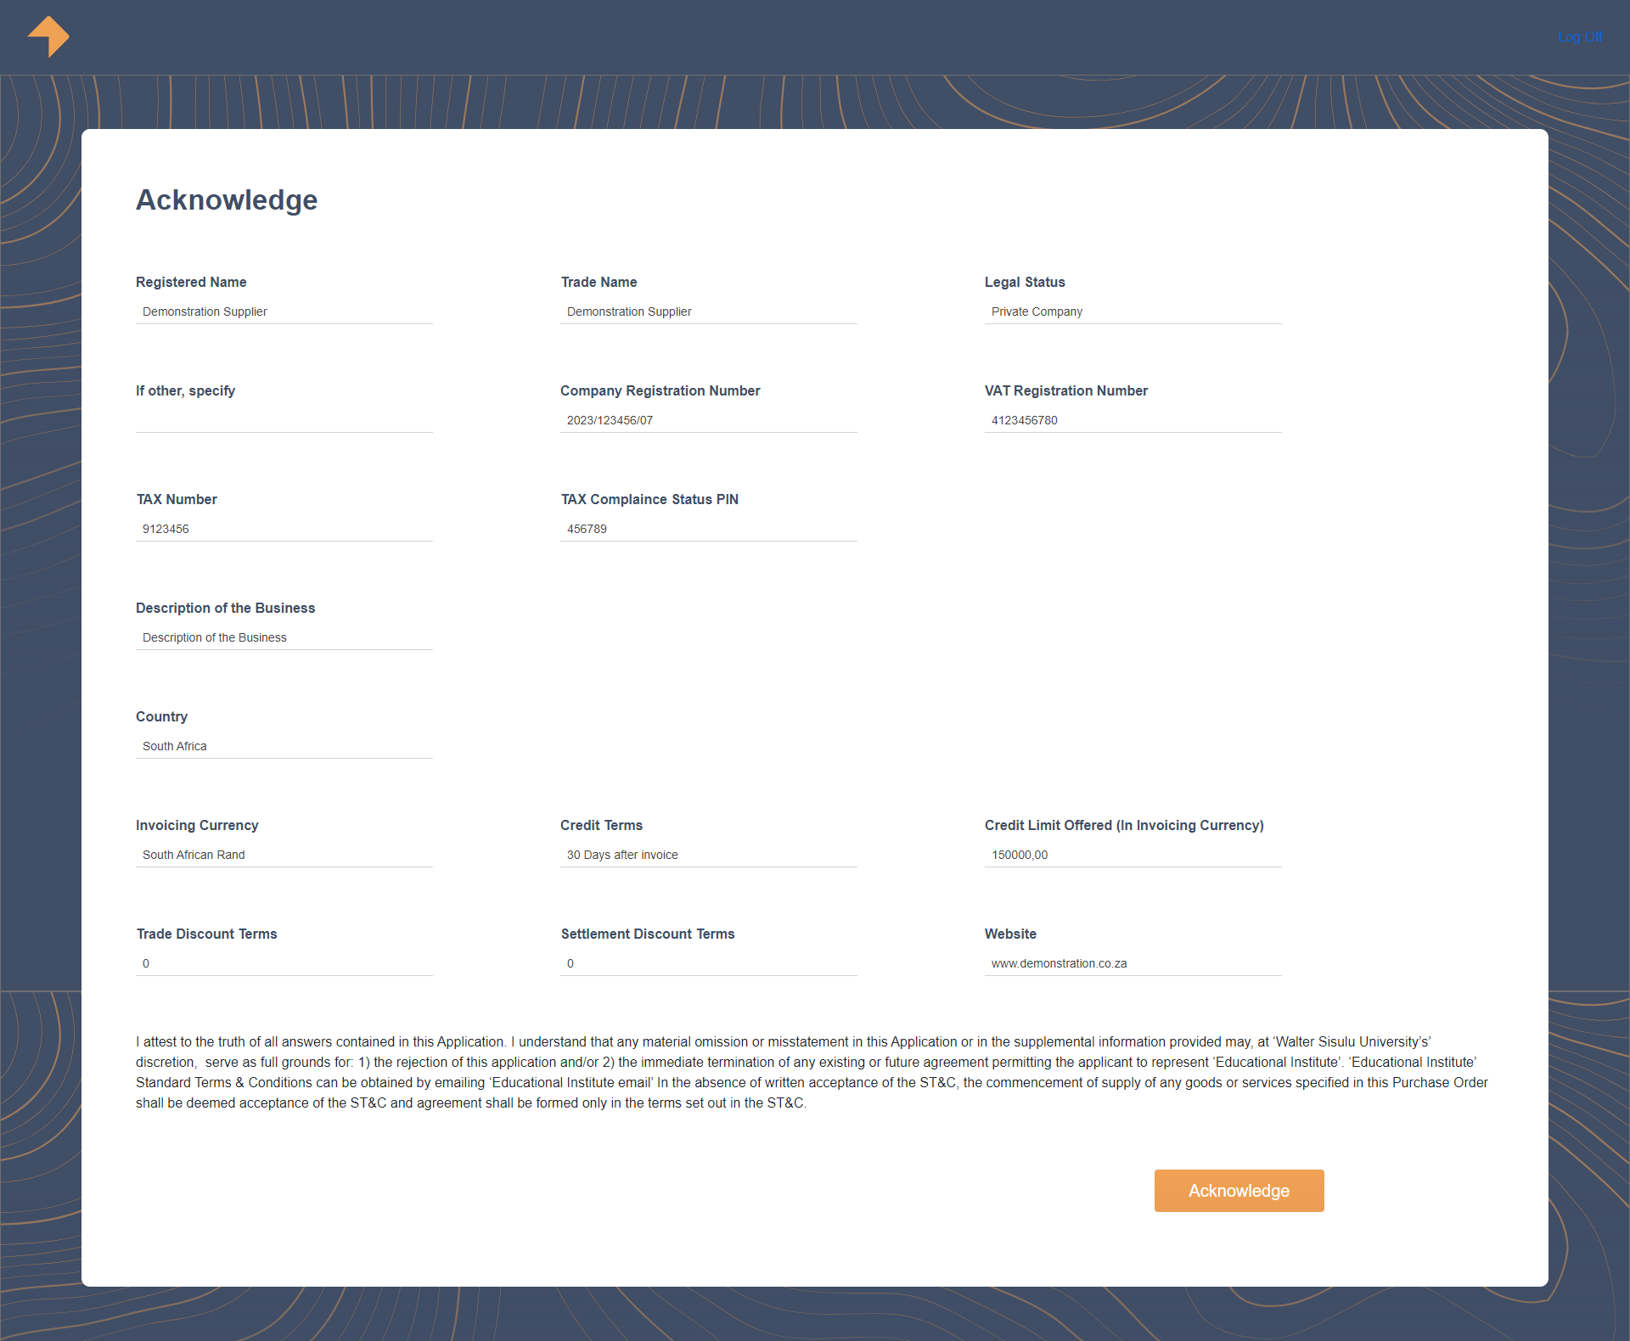
11

Slide 12
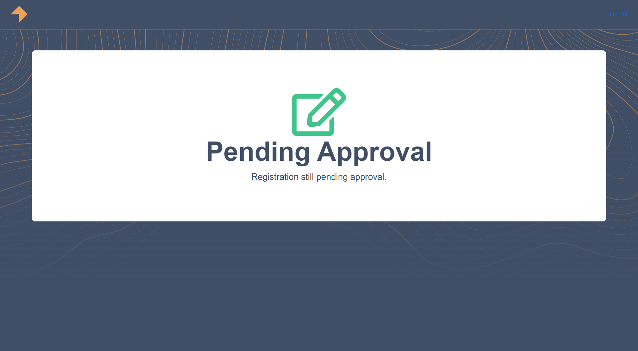
12

Slide 13
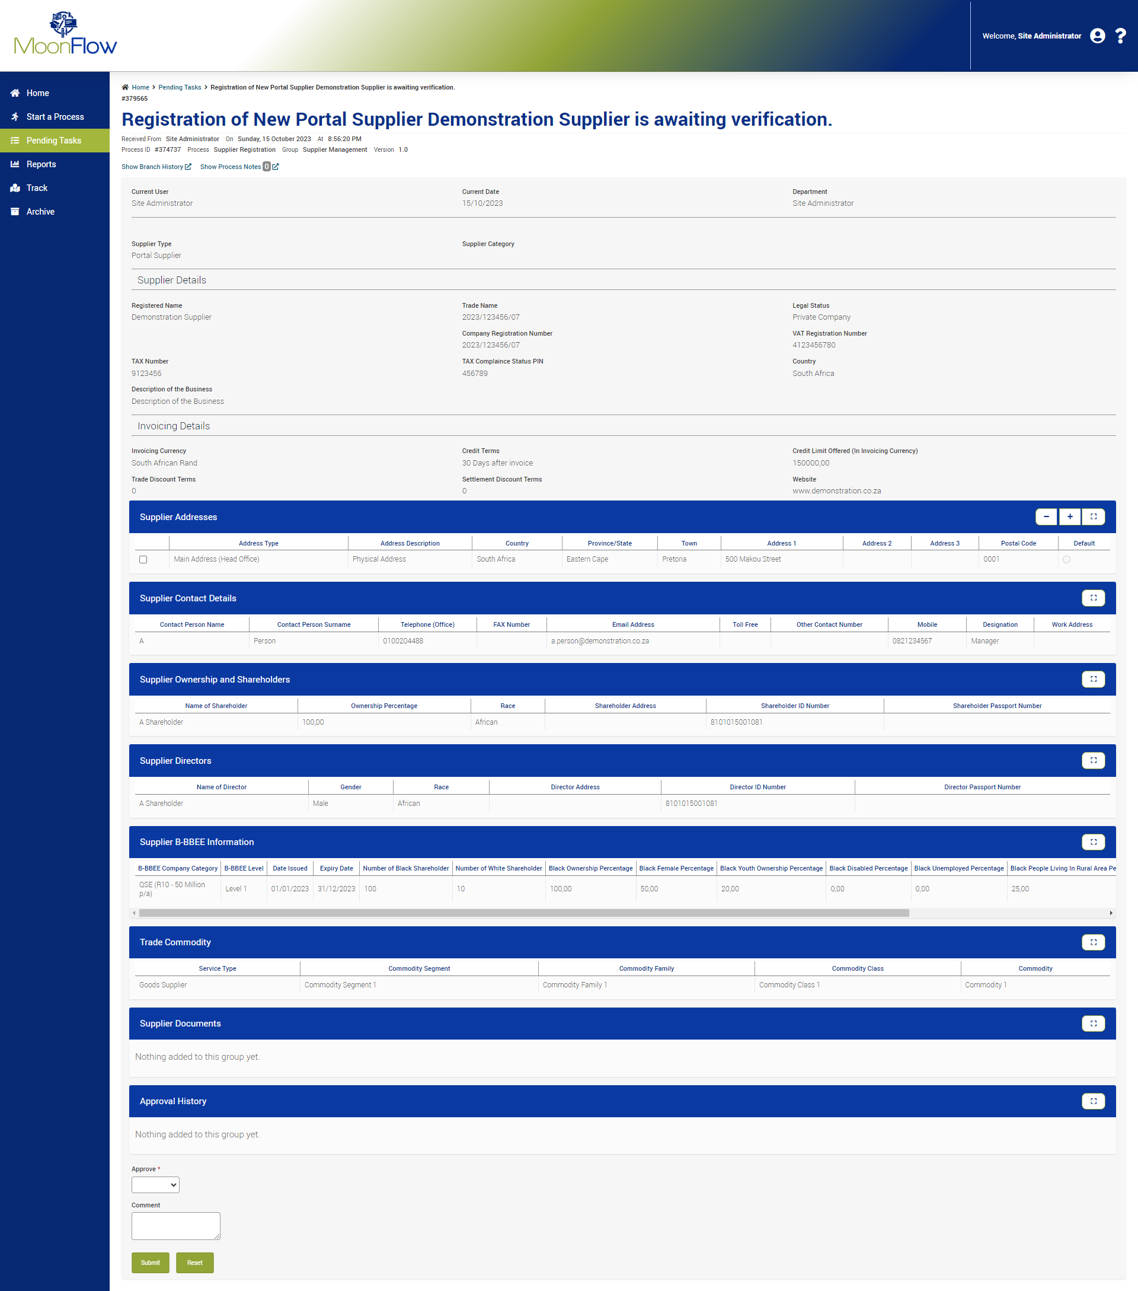
13

Slide 14
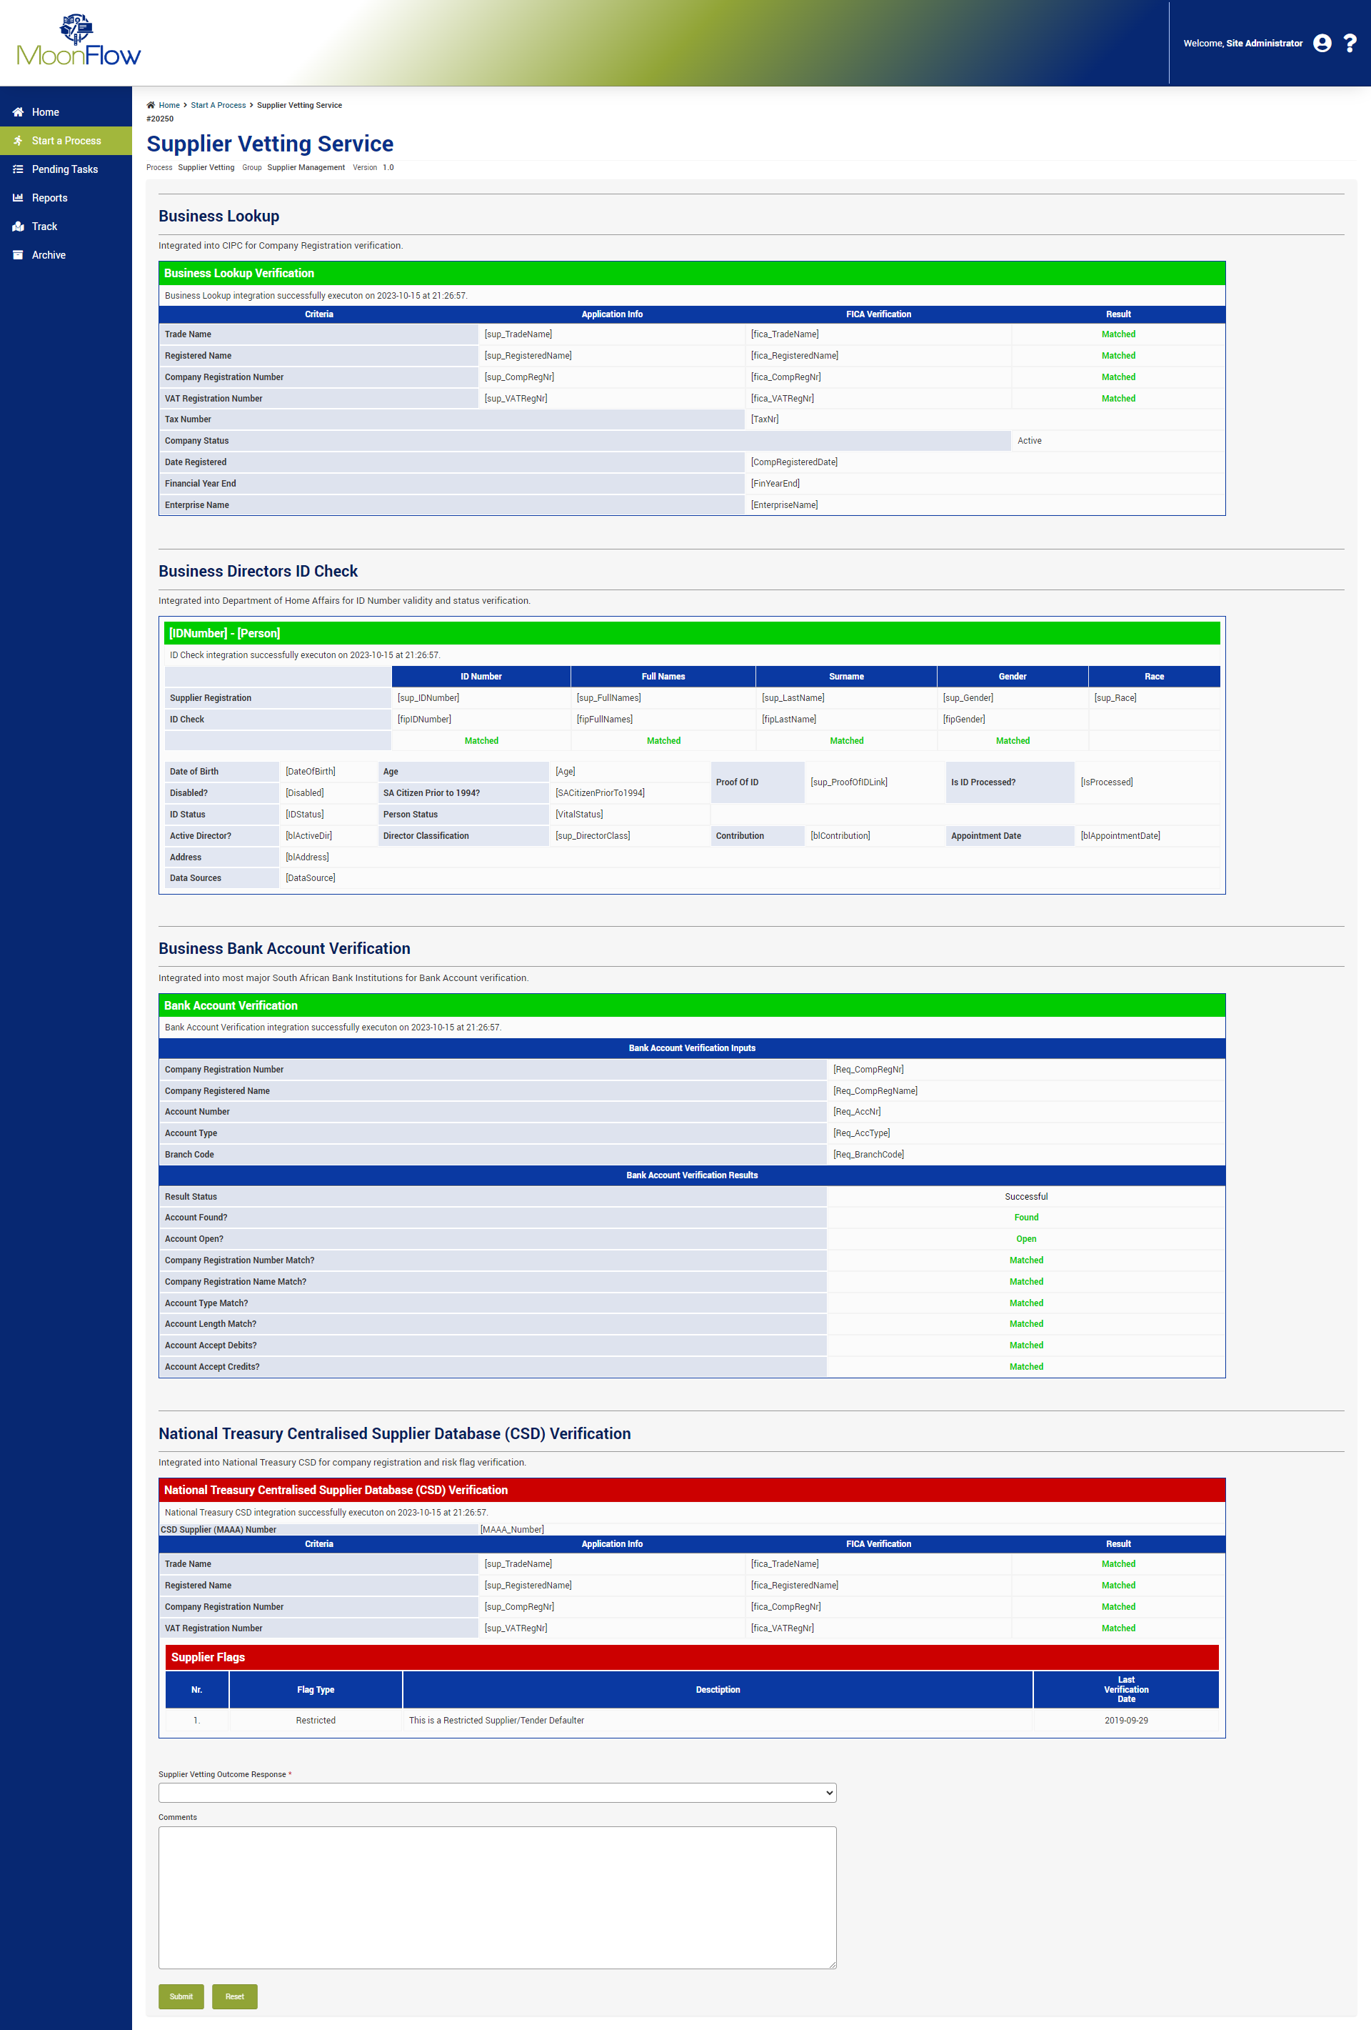
14

Slide 15
Supplier Rotation within RFQ’s
Disclaimer:
System demonstration to be presented after focused functionality showcase.

Slide 16

Procurement
Process
Procurement Process
16

Slide 17
17
Supplier Rotation
Disclaimer:
System demonstration to be presented after focused functionality showcase.

Slide 18
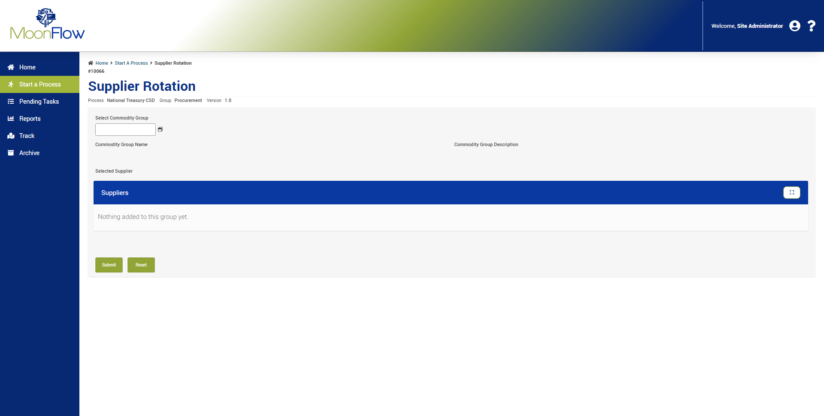
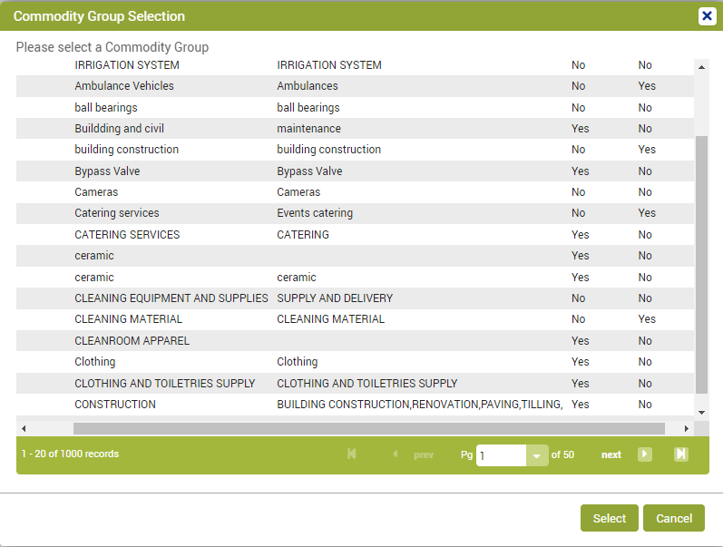
18

Slide 19
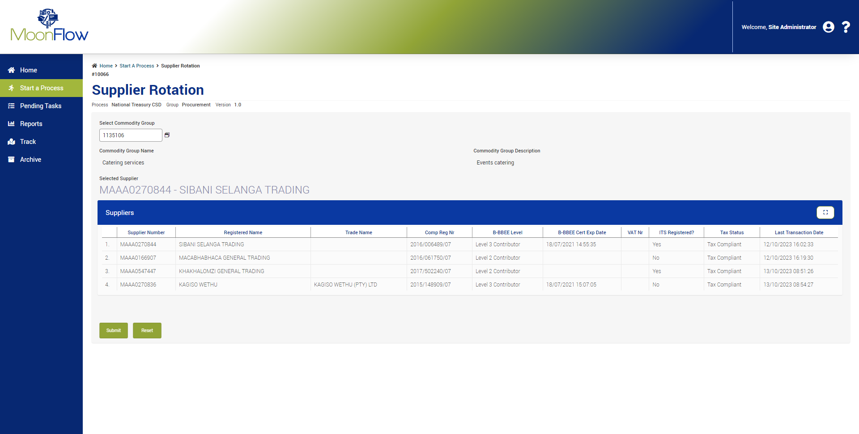
19

Slide 20

20

Slide 21
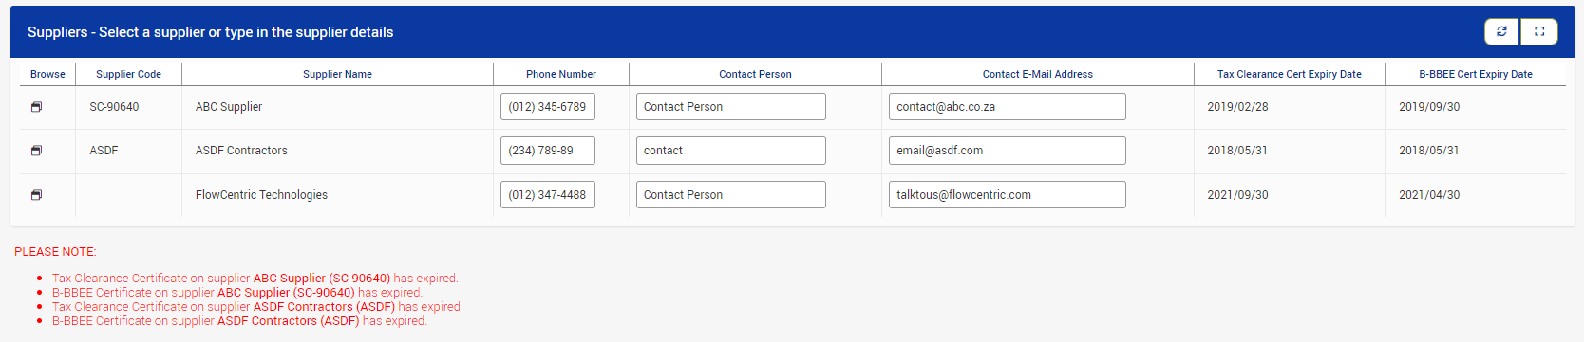
21

Slide 22
MoonFlow Phased Implementation
PHASE 1: Supplier Registration and Administration
PHASE 2: Supplier Rotation (RFQ) and Contract Management
PHASE 3: Tender Management

Slide 23

Way Forward
Interested Institutions to contact
  Adapt IT MoonFlow Champion name
  Xolelwa Olayi or Mzimhle – details here
Scoping session quote will be supplied to the Institution
Upon acceptance schedule Scoping Session at Institution
Complete Scoping Session
Submit a formal quote to the Institution for timelines and implementation
Acceptance
Implementation including User Acceptance Testing, Workshops and Training
Go Live, Support and Maintenance

Slide 24

Questions?

